Slide 1





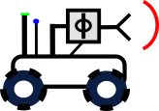
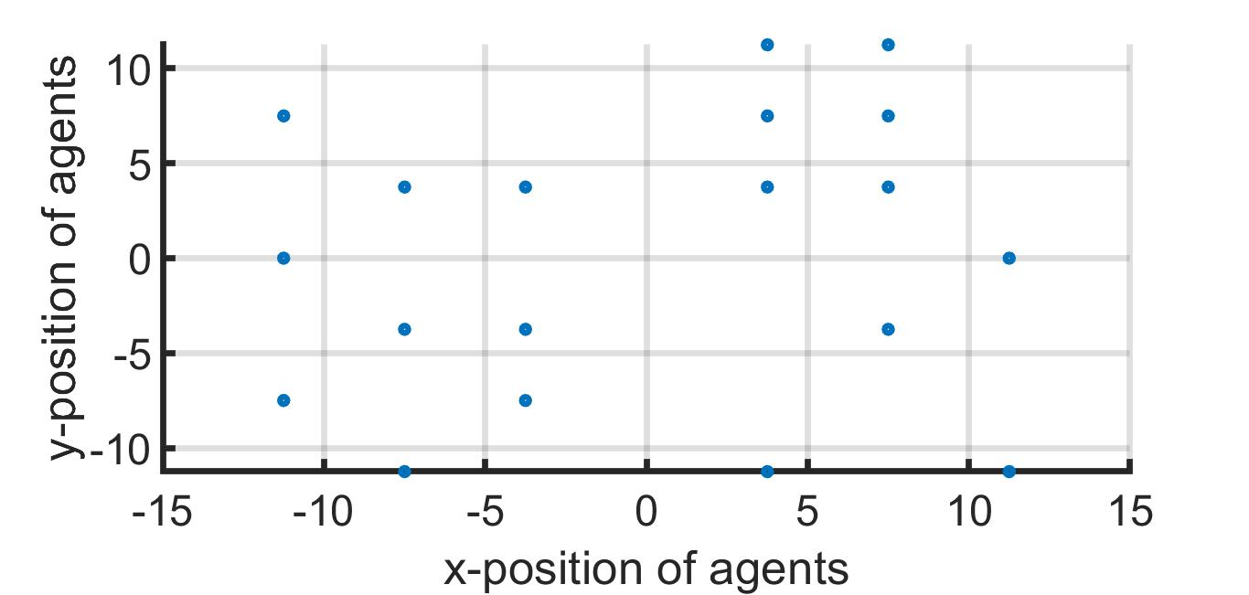
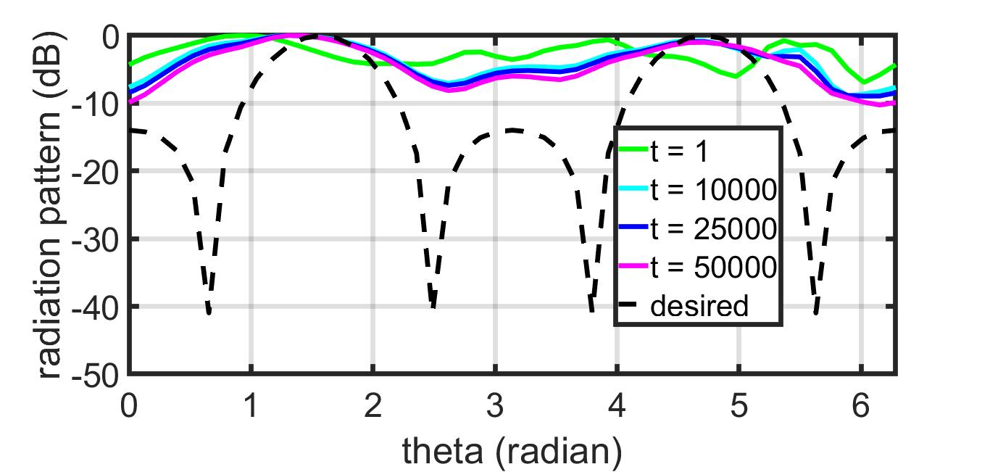
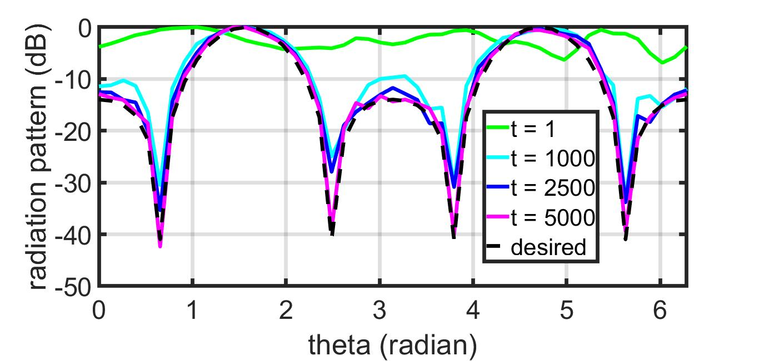
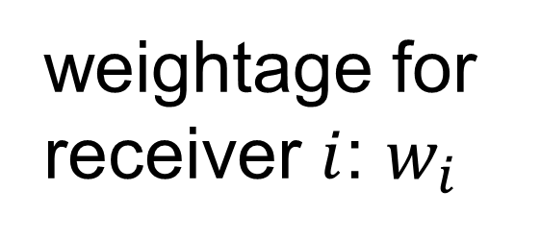
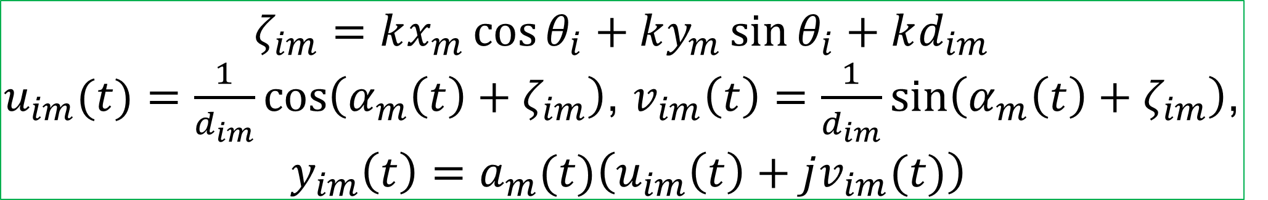
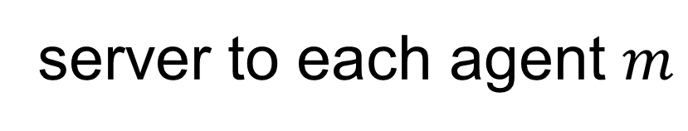
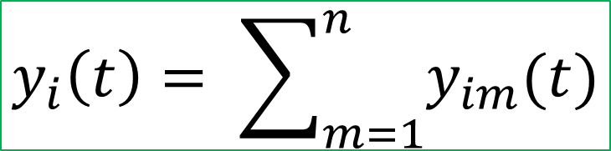

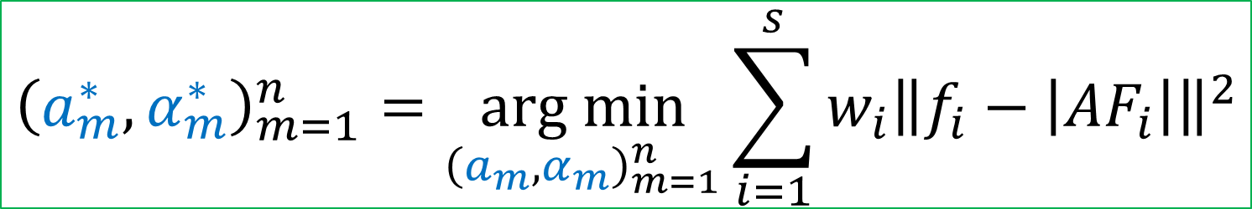
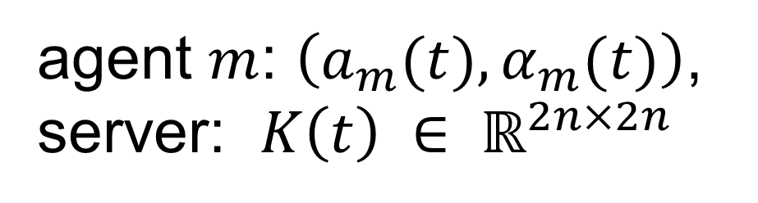



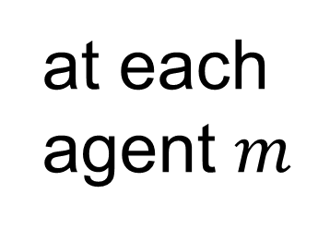
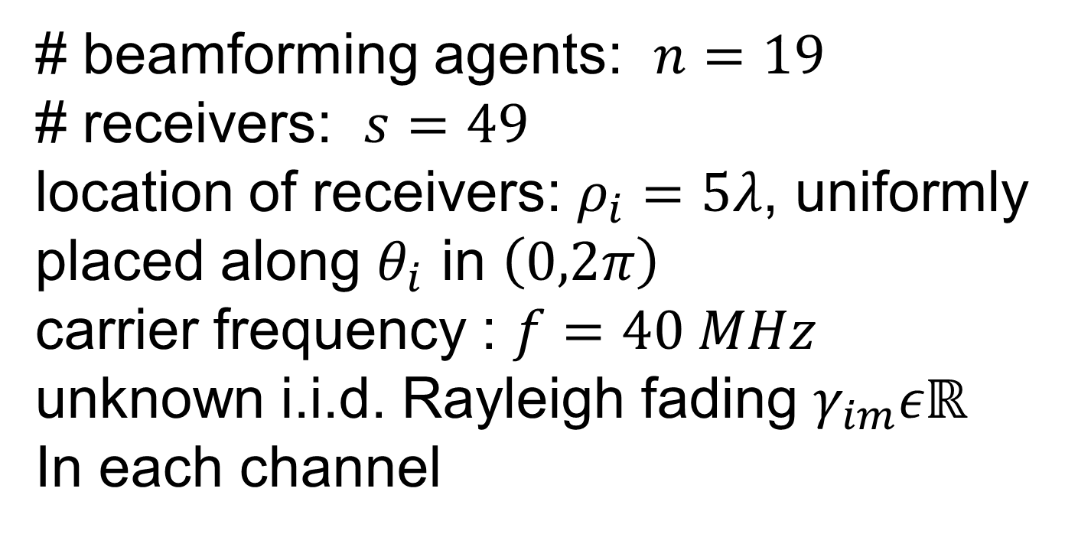
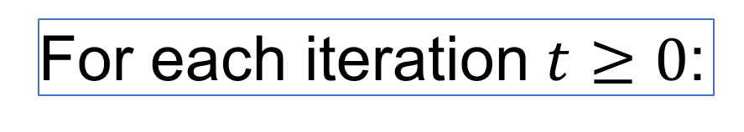
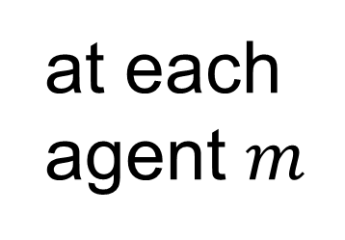
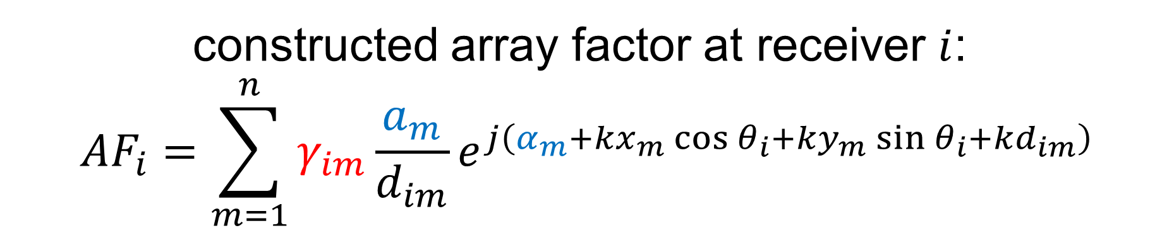
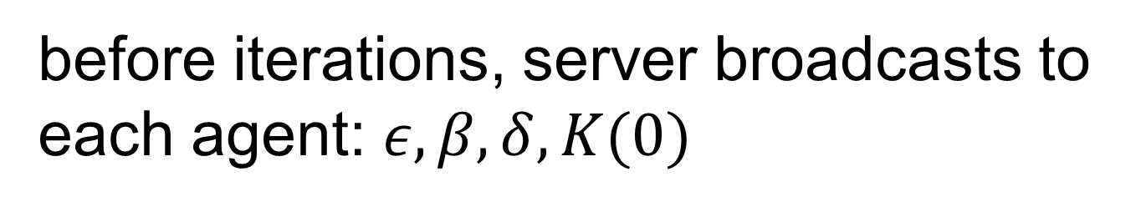
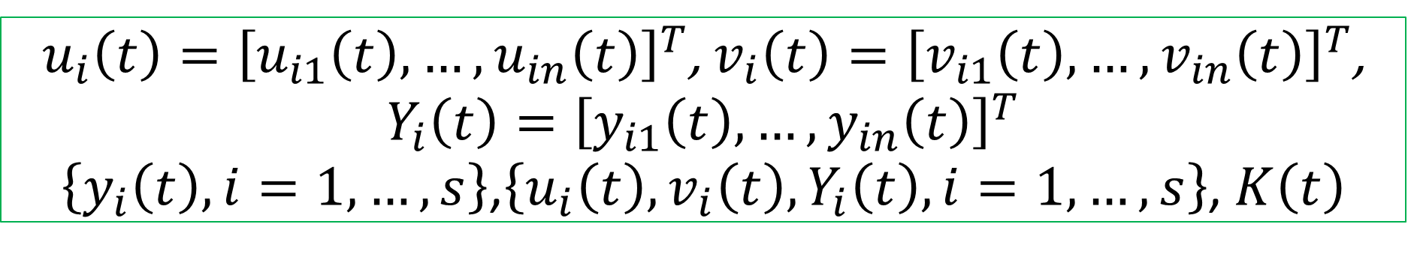
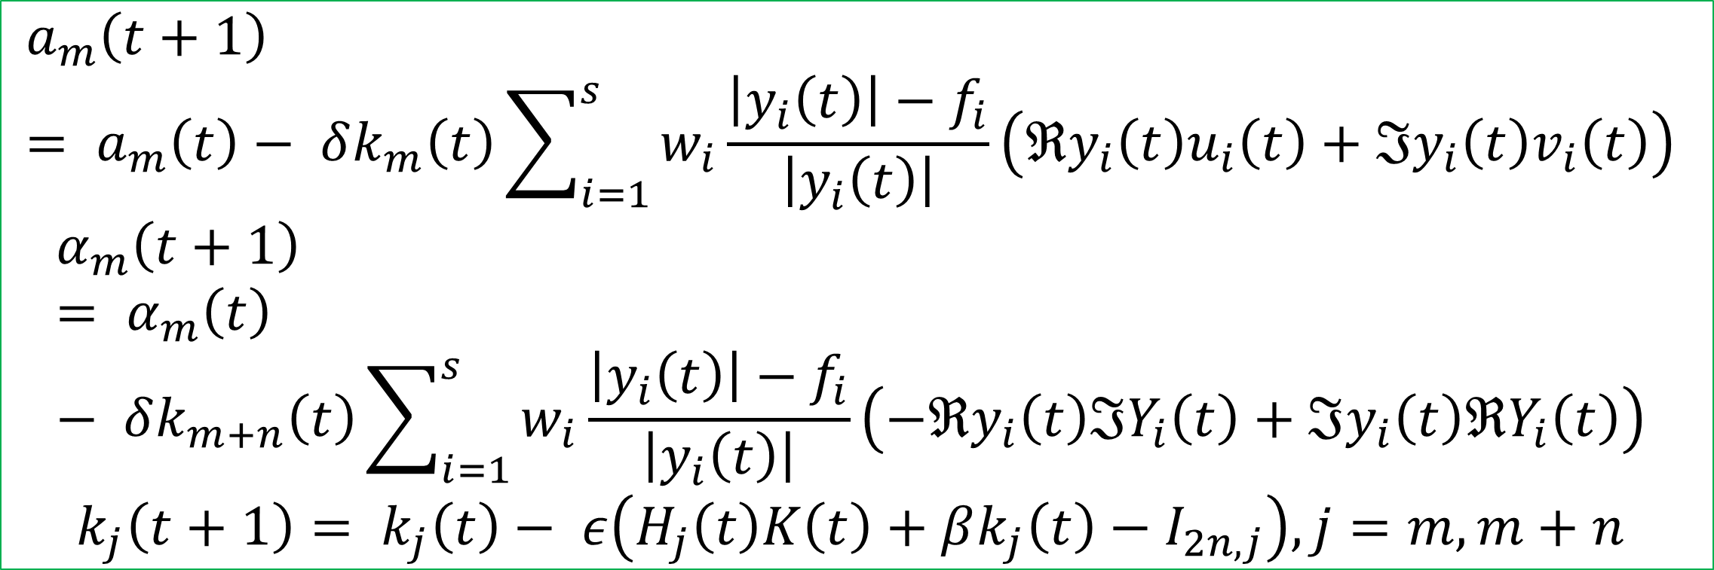

Project 1.6: Distributed Robotic Beamforming
Kushal Chakrabarti (UMD), Amrit S. Bedi (UMD), Fikadu T. Dagefu (ARL), Jeffrey N. Twigg (ARL), Nikhil Chopra (UMD, PI)
Project Summary: investigating the intersection of AI, autonomy, and networked communication, focusing on robots that self-configure to build covert, reliable communication links
Research Goals: to investigate self-configuring algorithms and technologies for robotic systems to create a dynamic multi-robot communications system
Anticipated Outcomes: constructively characterize the minimum required number of agents for generating an arbitrary far-field radiation pattern, develop policy gradient-based accelerated RL algorithms for distributed beamforming
Army Capability: increased command post (CP) maneuverability while maintaining covert operations through sophisticated signature management strategies
Problem Formulation
Comparison with Related Works
beamforming agents: $m=1,…,n$
receivers: $i=1,…,s$
location of agent $m$: $\left(x_{m},y_{m}\right)$
location of receiver $i$: $\left(ρ_{i},θ_{i}\right)$
desired array factor amplitude at receiver $i$: $f_{i}$
distance between agent $m$ and receiver $i$:
$$d_{im}=\sqrt{{\left(x_{m}−ρ_{i}cos{θ_{i}}\right)}^{2}+{\left(y_{m}−ρ_{i}sin{θ_{i}}\right)}^{2}}$$
excitation signal amplitude and phase of agent $m$: $\left(a_{m},α_{m}\right)$
synchronized carrier frequency : $f$
wavenumber: $k=\frac{2πf}{3×{10}^{8}}$ Hz/m
Prior Work | Our Work
objective: maximizing gain or steering nulls at specific locations | objective: beampattern matching advantages: precise control over desired power at multiple locations, inherent simultaneous beamforming and nullforming in constructive manner, can include additional constraints (limited transmit power, derivative constraints when receiver locations are not precisely known)
utilize receiver feedbacks | does not require receiver feedbacks
sparse beamforming, mobile agents | fixed number of agents, stationary agents
channel model-free, probabilistic channel prediction and path planning for minimizing power | feedback-free objective of beampattern matching
receiver feedback-free | does not assume line-of-sight channels
constructed array factor at receiver $i$:
$${AF}_{i}=\sum_{m=1}^{n}{γ_{im}\frac{a_{m}}{d_{im}}e^{j\left(α_{m}+kx_{m}\cos{θ_{i}}+ky_{m}\sin{θ_{i}+kd_{im}}\right)}}$$
Coherent
Phase Front
Null receivers
weightage for receiver $i$: $w_{i}$
Distributed
Across
Robots
unknown multipath fading
control parameters
$${\left(a_{m}^{∗},α_{m}^{∗}\right)}_{m=1}^{n}=\underset{{\left(a_{m},α_{m}\right)}_{m=1}^{n}}{arg min}{\sum_{i=1}^{s}{w_{i}{\left\|f_{i}−\left|{AF}_{i}\right|\right\|}^{2}}}$$
Proposed Algorithm: IPG-DB
proposed a novel algorithm: Iteratively Pre-conditioned Gradient-descent for Distributed Beamforming (IPG-DB)
significantly faster than the gradient-descent (GD) based methods
can be incorporated in alternate optimization framework for joint optimization of position, sparsity, and excitation: replace slower GD with faster IPG-DB
does not rely on receiver feedbacks
does not assume channel fading parameters: robust to noise
agent $m$: $\left(a_{m}(t),α_{m}(t)\right)$, server: $K\left(t\right) ∈ ℝ^{2n×2n}$
before iterations, server broadcasts to each agent: $ε, β, δ, K(0)$
For each iteration $t≥0$:
Phase Controller
$$ζ_{im}=kx_{m}\cos{θ_{i}}+ky_{m}\sin{θ_{i}+kd_{im}}$$
$u_{im}(t)=\frac{1}{d_{im}}\cos\left(α_{m}\left(t\right)+ζ_{im}\right)$, $v_{im}\left(t\right)=\frac{1}{d_{im}}\sin\left(α_{m}\left(t\right)+ζ_{im}\right)$,
$y_{im}\left(t\right)=a_{m}(t)\left(u_{im}\left(t\right)+jv_{im}(t)\right)$
Proposed Settings of Beamforming Agents
at each agent $m$
Simulation Results: Synthetic Data
server
$\left\{u_{im}\left(t\right),v_{im}\left(t\right),y_{im}\left(t\right), i=1,…,s\right\}$, $k_{m}\left(t\right),k_{m+n}\left(t\right)$
# beamforming agents: $n=19$
# receivers: $s=49$
location of receivers: $ρ_{i}=5λ$, uniformly placed along $θ_{i}$ in $\left(0,2π\right)$
carrier frequency : $f=40 MHz$
unknown i.i.d. Rayleigh fading $γ_{im}εℝ$
In each channel
agent $m$ to server
at server
$$y_{i}\left(t\right)= \sum_{m=1}^{n}{y_{im}(t)}$$
Tx agents
server to each agent $m$
$$a_{1},α_{1}$$
$$a_{2},α_{2}$$
$$a_{m},α_{m}$$
Far-field Rx
$u_{i}\left(t\right)={\left[u_{i1}\left(t\right),…,u_{in}\left(t\right)\right]}^{T}$, $v_{i}\left(t\right)={\left[v_{i1}\left(t\right),…,v_{in}\left(t\right)\right]}^{T}$, $Y_{i}\left(t\right)={\left[y_{i1}\left(t\right),…,y_{in}\left(t\right)\right]}^{T}$
$\left\{y_{i}\left(t\right), i=1,…,s\right\}$,$\left\{u_{i}\left(t\right),v_{i}\left(t\right),Y_{i}\left(t\right), i=1,…,s\right\}$, $K\left(t\right)$
server-agent based setting
agents can communicate with a common server
no peer-to-peer communication
what is a server?
can be an auxiliary node, located close to the agents
can exchange information with the agents
can process information (addition, multiplication, etc. basic operations)
need not know the beamforming coefficients, agents’ and receivers’ locations, desired beam and null values
at each agent $m$
$$a_{m}\left(t+1\right)= a_{m}\left(t\right)− δk_{m}\left(t\right)\sum_{i=1}^{s}{w_{i}\frac{\left|y_{i}\left(t\right)\right|−f_{i}}{\left|y_{i}\left(t\right)\right|}}\left(ℜy_{i}\left(t\right)u_{i}\left(t\right)+ℑy_{i}\left(t\right)v_{i}\left(t\right)\right)$$
$$α_{m}\left(t+1\right)= α_{m}\left(t\right)− δk_{m+n}\left(t\right)\sum_{i=1}^{s}{w_{i}\frac{\left|y_{i}\left(t\right)\right|−f_{i}}{\left|y_{i}\left(t\right)\right|}}\left(−ℜy_{i}\left(t\right)ℑY_{i}\left(t\right)+ℑy_{i}\left(t\right)ℜY_{i}\left(t\right)\right)$$
$$k_{j}\left(t+1\right)= k_{j}\left(t\right)− ε\left(H_{j}\left(t\right)K\left(t\right)+βk_{j}\left(t\right)−I_{2n,j}\right), j=m,m+n$$
GD
IPG-DB
This research is supported by U.S. Army Grant No. W911NF2120076

